Slide 1
CAR Administration Overview
Module 7 – Supplement - Tricks and Tips

Slide 2
Views

Slide 3
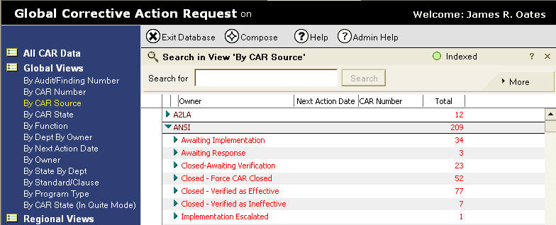
Global Views
Global View “By CAR Source” – View CARs by the source for the CAR

Slide 4
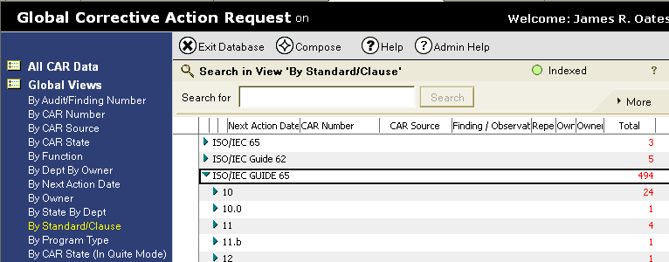
Global Views
Global View “By Standard” – Allows ability to view those CARs against specific standards. Useful for looking for duplicate CARs

Slide 5
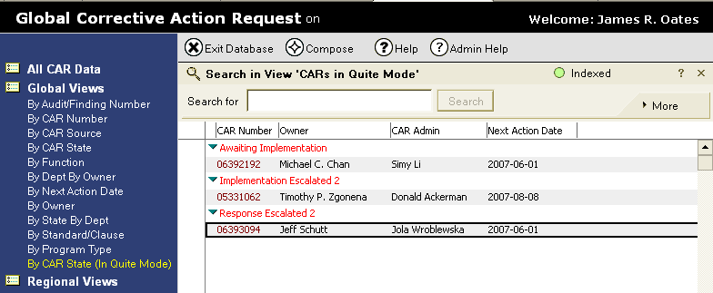
Global Views
Global View “In Quiet Mode” – Allows ability to view those CARs that were left in Quiet Mode in error (no emails are sent in this mode, so they escalate in silence)

Slide 6
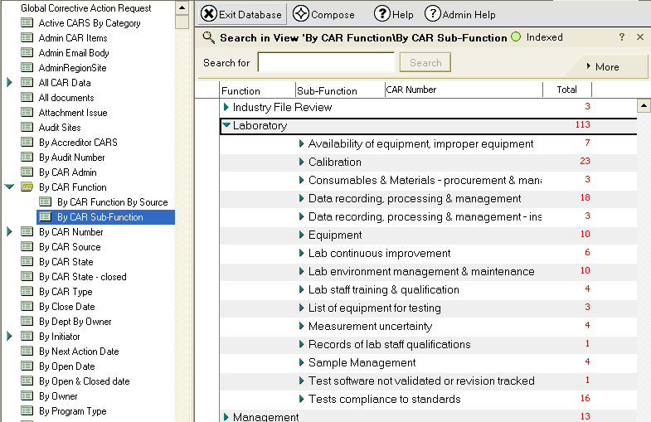
View → Go To →
By CAR Function→By Sub-Function
Shows a view of all open CARs by their Sub-Function
Useful for looking for similar CARs, systemic issues, etc.

Slide 7
Searches

Slide 8
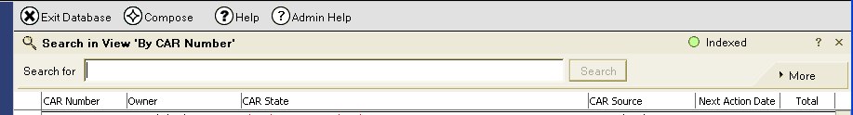
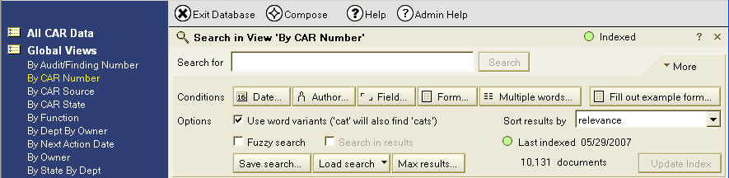
Search Features in CAR Tool:
View →Search This View, then More

Slide 9
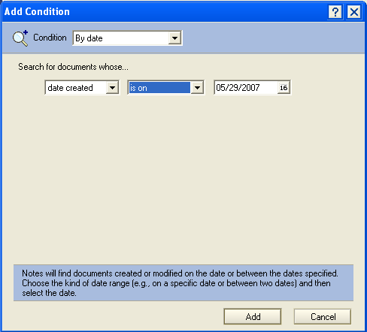
Search Features in CAR Tool:
“Date”, “Author”
Both bring up the same form defaulted to either ‘Date’ or ‘Author’

Slide 10
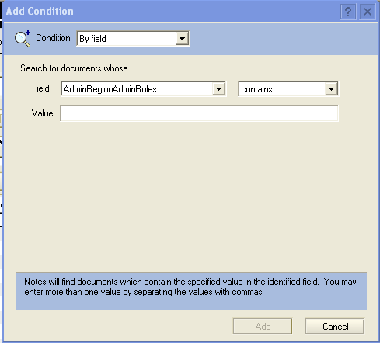
Search Features in CAR Tool:
“Field”
Field: Ability to search by information in specific fields (multiple values can be added by separating by commas)

Slide 11
Search Features in CAR Tool:
“Form”, “Multiple Words”, Example Form
‘Form’ and ‘Multiple Words’: Not useful
‘Fill out example form’: VERY powerful

Slide 12
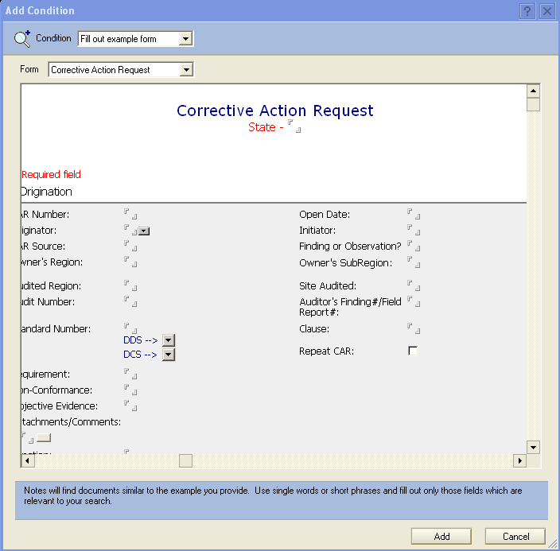
‘Fill out example form’
Logical operators work (AND, OR, NOT, etc.)
Ability to complete a CAR form with information relevant to your search
Can be used with the other methods to allow the ability to refine searches
VERY powerful search tool available in Notes

Slide 13
Example of search
Are there any open ANSI Finding CARs relating to competency?

Slide 14
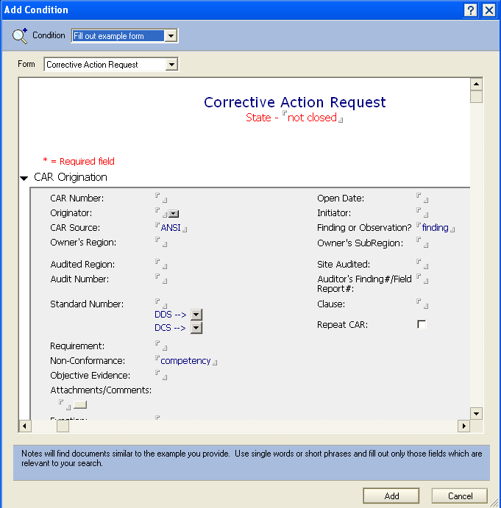
Example of search
Are there any open ANSI Finding CARs relating to competency?
Note the use of the logical operator ‘not’
Click Add button

Slide 15
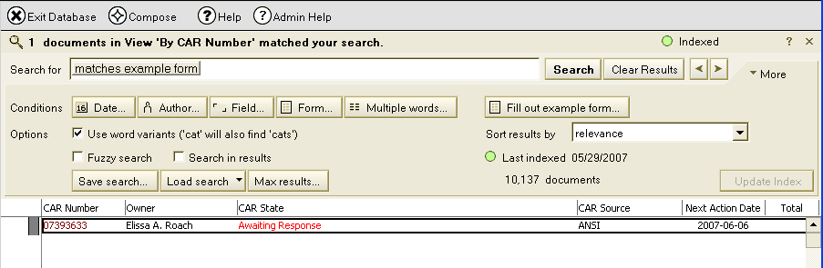
Search results
Are there any open ANSI Finding CARs relating to competency?
One CAR met these criteria

Slide 16
Modify search
Are there any open Closed Awaiting Verification ANSI Finding CARs relating to competency?

Slide 17
Modify search
Are there any open Closed Awaiting Verification ANSI Finding CARs relating to competency?
1. Double-click to re-open search criteria

Slide 18
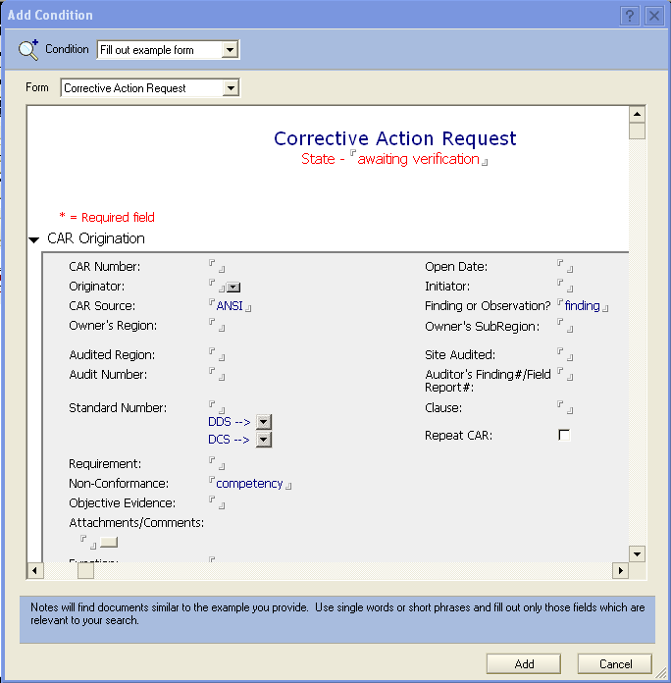
Modify search
Are there any open Closed Awaiting Verification ANSI Finding CARs relating to competency?
2. Enter the revised CAR state
3. Click Add Button

Slide 19
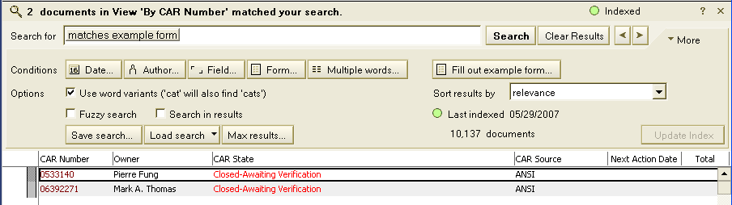
Search results
Are there any open Closed Awaiting Verification ANSI Finding CARs relating to competency?
Two CARs met these criteria

Slide 20
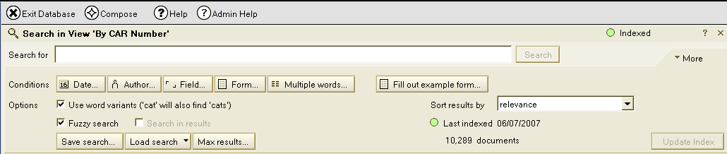
Other Search Tips
Word Variants – Allows the search to include words with various prefixes and suffixes to the search terms
Fuzzy Search – This is a more intelligent search that further expands the search to adjust for misspelled words and more variants.
Indexing – It is required that the database be ‘indexed’ for these search options to function.

Slide 21
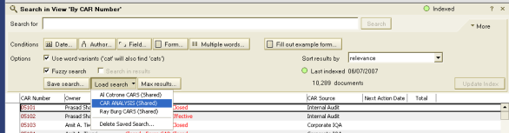
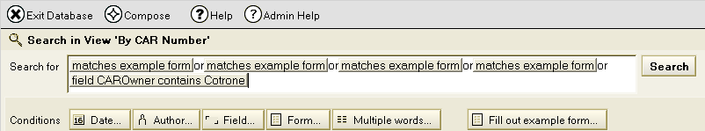
Pre-Loaded Searches
Load Search – There are some saved searches that can be used to build your own. Example: “Al Cotrone” CARs shows those CARs where Al Cotrone’s name is in the Owner or any Manager’s field.
Once Loaded – The fields can be adjusted to create your own customized search.

Slide 22
Tables and Links

Slide 23
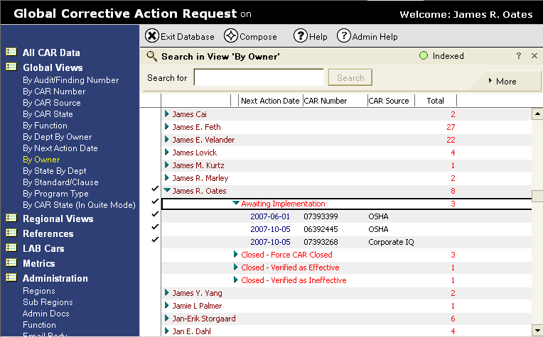
Creating a Table of CARs to add to an email
Step 1: Open the view and select the CARs

Slide 24
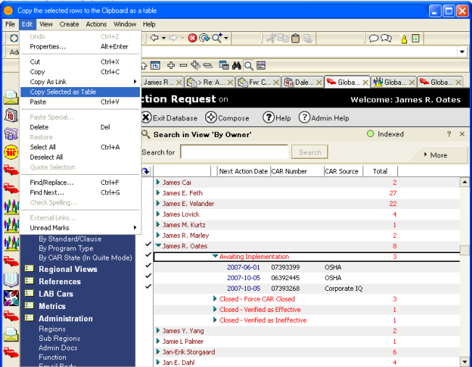
Creating a Table of CARs to add to an email
Step 2: After selecting the CARs, select Edit→Copy Selected as Table

Slide 25
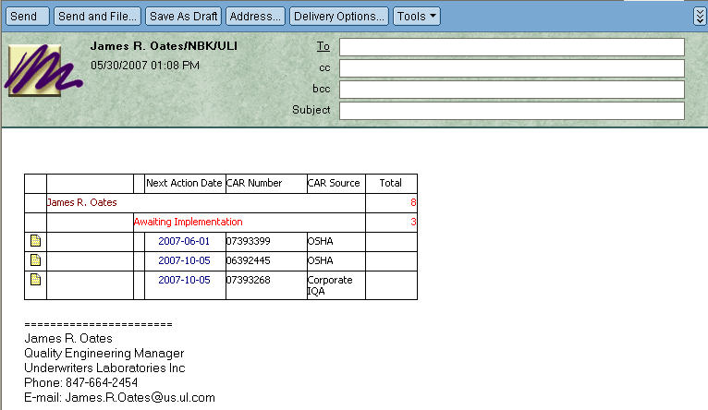
Creating a Table of CARs to add to an email
Step 3: In the new email,
CTRL–C to paste the table into the email. Note the links to the CARs are active!

Slide 26
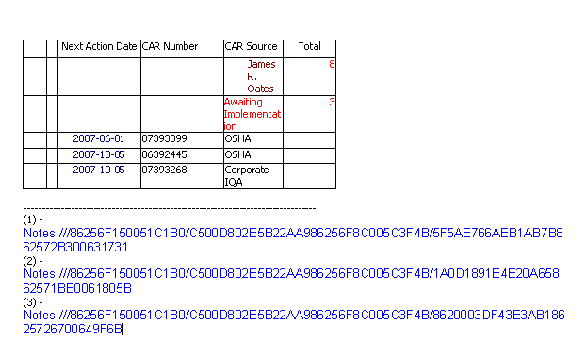
Pasting Linkable Table to a Microsoft Word document
Step 4: CTRL–C to paste the table into the Word document. Note the links to the CARs are active as a list of footnotes below the table.

Slide 27
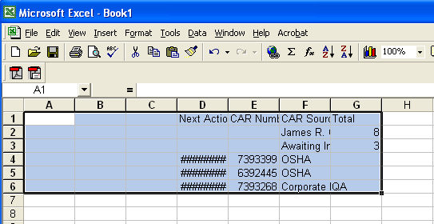
Pasting Linkable Table to Microsoft Excel A
Step 5: CTRL–C to paste the table into the spreadsheet. Note there are NO LINKS! These can be added from the Word document. . .

Slide 28
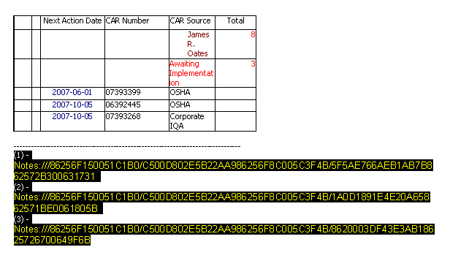
Pasting Linkable Table to Microsoft Excel B
Step 6: Back to the Word Document, highlight the ‘footnotes’ and copy them
(CTRL-C).

Slide 29
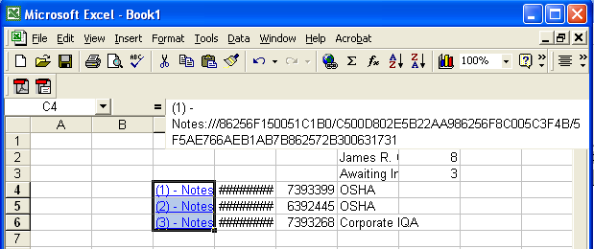
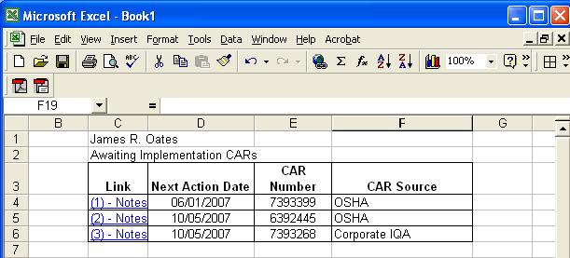
Pasting Linkable Table to Microsoft Excel C
Step 7: Click on the empty cell on the row of the first CAR,
CTRL–C to paste the links into the spreadsheet.
Step 8: Clean up the formatting, and the result is a spreadsheet with active links.

Slide 30
End of Module 7
Revision 1.0 – Version presented to EULA team June 2007, complies with 00-QA-S0010 Issue 6.0 and 00-QA-J0029 Issue 1.0.

